Slide 1
ASP.NET Core
Program class is the entry point of our ASP.NET Core Application, where we configure the web host, configure and register required services and configure middleware pipelines.
In ASP.NET Core, the Program class is the entry point for our ASP.NET Core Web Application. It contains the application startup code where we need to
Configure the Web Host, i.e., to host the ASP.NET Core Web Application.
Configure and register the services required by the application, such as MVC, Web API, Razor Pages, etc.
Register Middleware Components, i.e., configure the Application Request Processing Pipeline such as Authentication, Authorization, Routing, etc.
Start the Application so that it can listen to HTTP Requests.

Slide 2
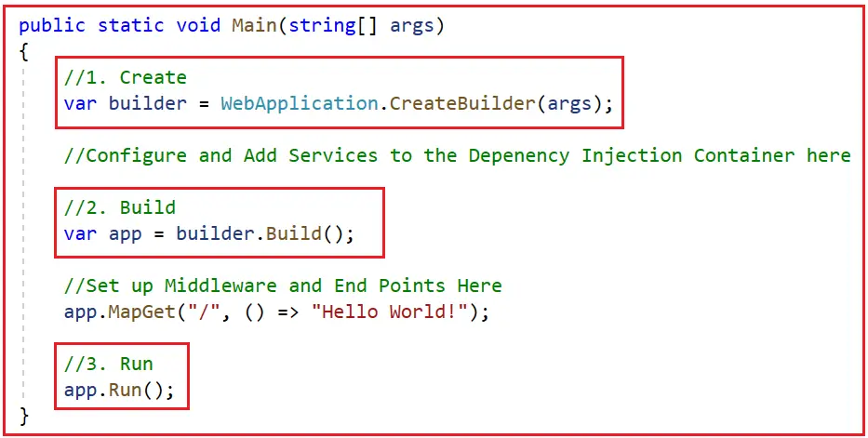
ASP.NET Core
The program file creates the web application in three stages. Create, Build, and Run, as shown in the below image.
Note: The earlier versions of ASP.NET Core created two files. One is Program.cs, and the other is Startup.cs. The Program.cs are responsible for configuring the host, and the startup class is responsible for configuring the Services and Middlewares. With .NET 6, both are merged into a Program.cs class file.

Slide 3
ASP.NET Core
Step 1: Create (Configuring Web Server, Host, and Services)
var builder = WebApplication.CreateBuilder(args);
The CreateBuilder is a static method of WebApplication class that accepts the Command line arguments as an input parameter. This method initializes a new instance of the WebApplicationBuilder class with preconfigured defaults such as.
Set up Web Server
Host the Application
Logging
Configuration
Dependency Injection Container
Adds Framework Provided Services
So, the CreateBuilder method creates, initializes, and returns a new instance of the WebApplicationBuilder class. And we then use the WebApplicationBuilder instance to configure and register additional services. The WebApplicationBuilder exposes the following.

Slide 4
ASP.NET Core
The WebApplicationBuilder exposes the following.
IWebHostEnvironment: It provides information about an application’s web hosting environment. It will provide information on whether the application is hosted using In-Process or OutOfProcess Hosting Model. Whether it is using IIS Server or Kestrel Web Server, or both.
IServiceCollection: A collection of services that can be used throughout an application. This is useful for adding user-provided or framework-provided services. It provides methods to register different types of services, such as Transient, Scoped, and Singleton services.
ConfigurationManager: A collection of configuration providers that can be used throughout an application. This is useful for adding new configuration sources and providers.
ILoggingBuilder: A collection of logging providers that can be used throughout an application. This is useful for adding new logging providers.

Slide 5
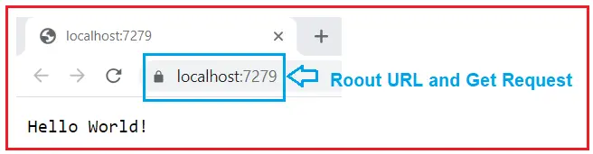
ASP.NET Core
Step 2: Build (Configuring the Middleware Components)
var app = builder.Build();
The Build method of the WebApplicationBuilder class creates a new instance of the WebApplication class. We then use the Web Application instance to set up the Middlewares and endpoints for our ASP.NET Core Application.
app.MapGet(“/”, () => “Hello World!”);
With the MapGet endpoint, when an HTTP GET request is sent to the application root URL /, then the request delegate executes, i.e., the statement () => “Hello World!” will execute, and Hello World! is written to the HTTP response. Now, run the application, and you should get the following output, this output is coming from the MapGet Endpoint.

Slide 6
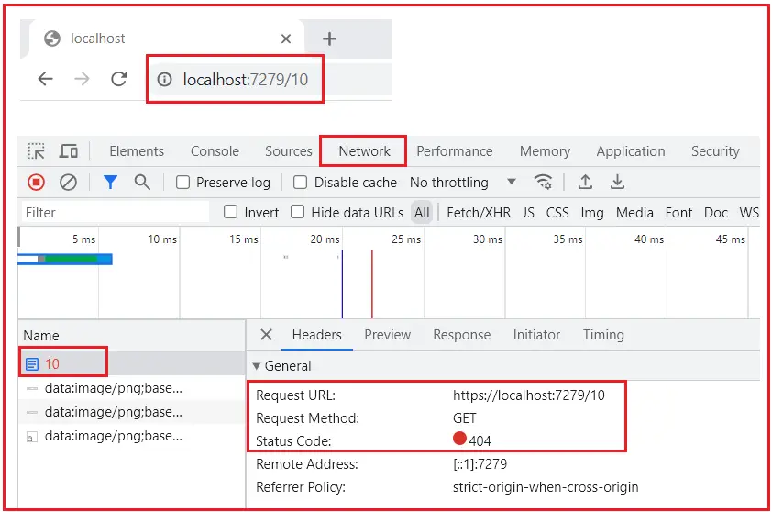
ASP.NET Core

Slide 7
Role of Main Method in ASP.NET Core
The Main Method of the Program.cs class is the entry point of our ASP.NET Core Application. It configures and builds the Web host. The Web Host is responsible for running our ASP.NET Core Applications. It does so by calling the CreateBuilder method, and most of the code required to configure the Web Host is already written for us within the CreateBuilder method.
First, the Main Create the WebApplicationBuilder instance using which we can configure required services for our ASP.NET Core Application.
Second, the Main method creates an instance of the WebApplication class, using which we can configure required Middleware Components or EndPoints, which will handle the incoming HTTP Requests.
Third, the Main method starts the application by calling the Run method.
The CreateBuilder method sets the web host with default configurations, such as it will host the application with the default server (i.e., either IIS or Kestrel) and with the default hosting model (i.e., InProcess or OutOfProcess).

